Slide 1

Real-time Emotion Recognition: The Power of Video Analysis
Ramapriya Ranganath
Silas Morris

Slide 2
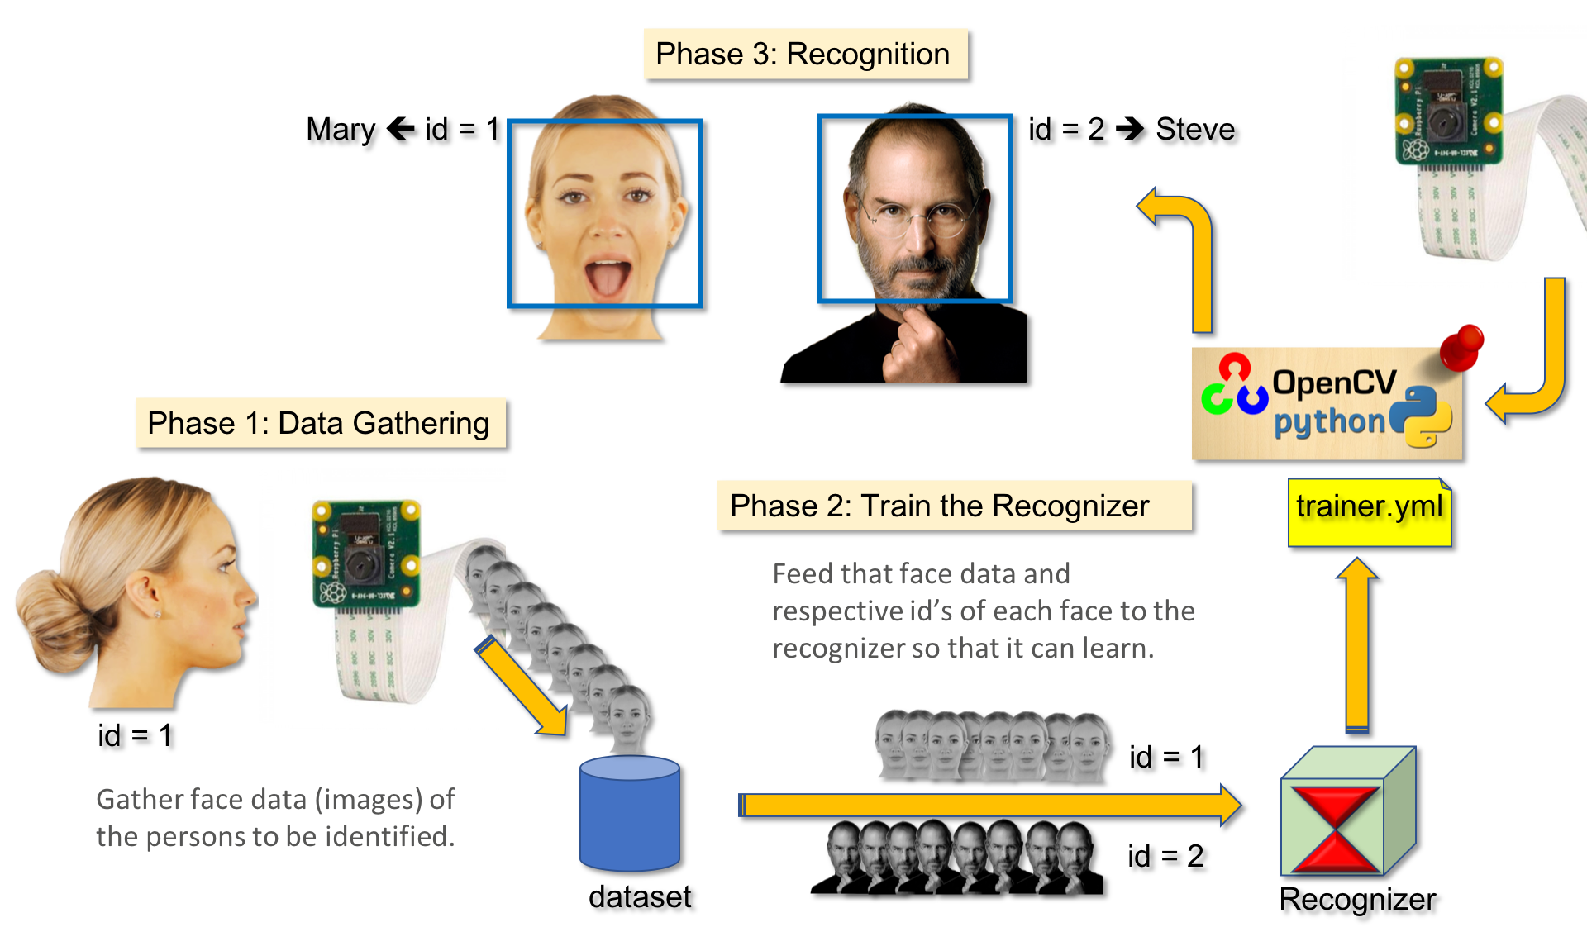
Introduction
It uses advanced computer vision techniques to analyze facial expressions and body language in real-time
This technology has applications in healthcare, marketing, and crime prevention
It can help improve communication, diagnose mental health conditions, and provide valuable insights into an individual's emotional state

Slide 3

STATS
In this project, we have selected patients with Central Nervous System (CNS) Breakdown as our target audience and helped them to alter their dosage on time
Affects 3 Million patients
55.8% Total spending is on Emergency Room and Inpatient care
63% of patients had a negative impact on their emotional well-being
45% had a negative impact on their ability to work.
20% had liver failure

Slide 4
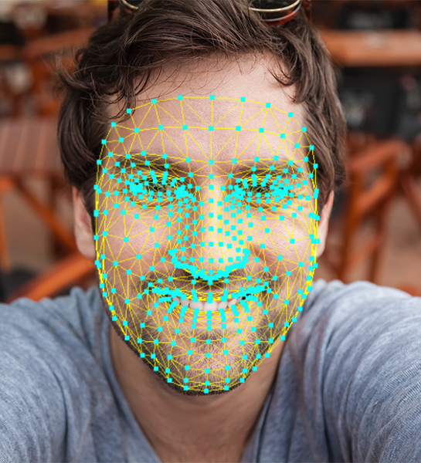
The Challenges of Real-Time Emotion Recognition
Real-time emotion recognition in video presents challenges
High-quality video data is needed for accurate emotion recognition
Low-resolution or noisy videos can lead to inaccurate results
Algorithms must be robust and adaptable
Emotions can be expressed in many different ways across different cultures, languages, and contexts. Here we have used FER 2013 from Kaggle
Emotions can change rapidly, so algorithms must be able to adapt to changes in emotional expression over time.

Slide 5
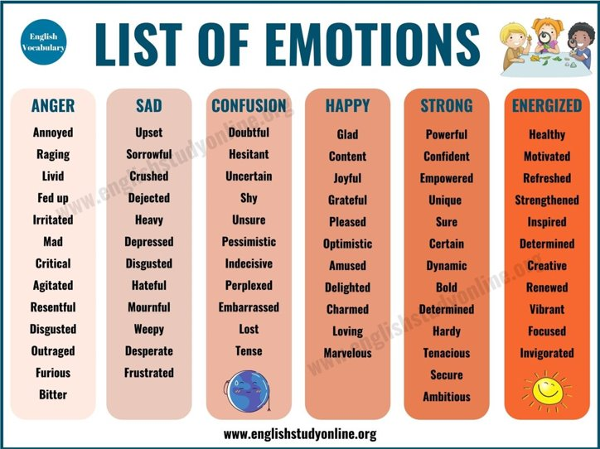

Facial Expression Recognition
MobileNetV2 is a convolutional neural network architecture that is designed to be efficient for mobile and embedded applications.
It takes as input images of size 224 x 224 pixels, which is the standard input size for the ImageNet dataset.
The original MobileNetV2 network was designed for image classification into 1000 classes,the last layer needs to be replaced with a new layer that consists of 7 output neurons, each corresponding to one of the 7 emotions.
Trained on a dataset of images labeled with the 7 emotions. During training, the weights of the new output layer will be updated to optimize the network's ability to classify emotions.
The performance of the modified MobileNetV2 network should be evaluated on a validation dataset to ensure that it is capable of accurately classifying emotions.

Slide 6
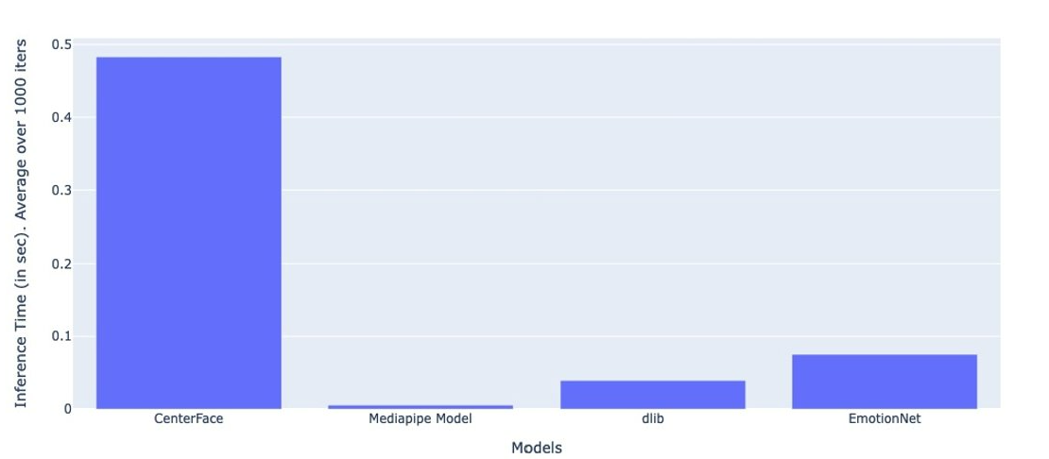
Graphs
We are showing that our model can be used in real-time applications.
1) CenterFace: its pretty accurate for even tiny faces and its trained on WiderFace dataset. This works for most of the cases.
2) mediapipe model is used to extract faces from selfie images. The face has to be near to the cam to extract faces. Otherwise, the model might fail
3) classical technique HOG + linear SVM. This is pretty fast and may work for challenging cases.
For our use case, all these models gave good results. Inference time is less for all the three models. <0.5 sec for face extraction and <0.5 sec for CenterNet. Our whole system works in real-time.
One can pick the model among these three based on their preferences:
Accurate face detection vs very fast detection
Final layer of MobileNetV2 is modified from 1000 classes to 7 class

Slide 7
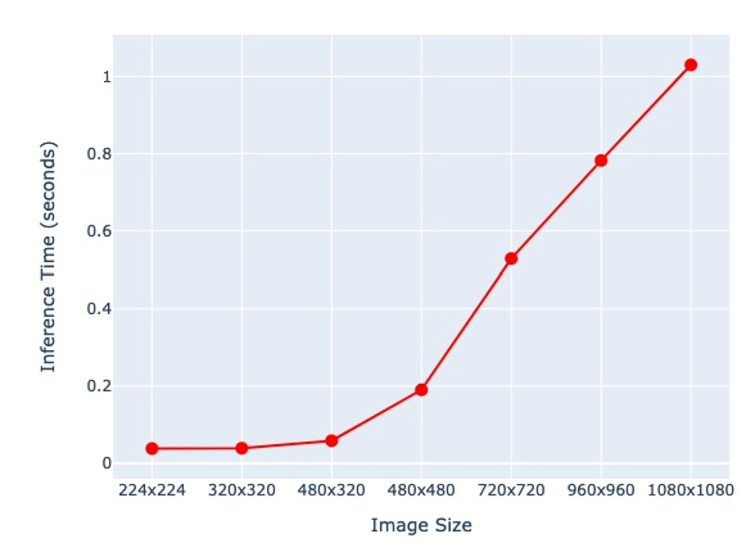
Graphs
Here we have resolution on x-axis and time in seconds on y-axis
As we increase resolution the time increases.
224x224 is the preferred resolution here as it is takes less time when compared to higher resolution ones

Slide 8
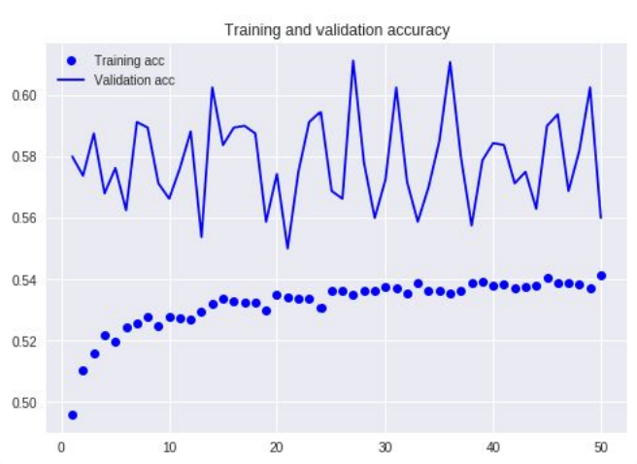
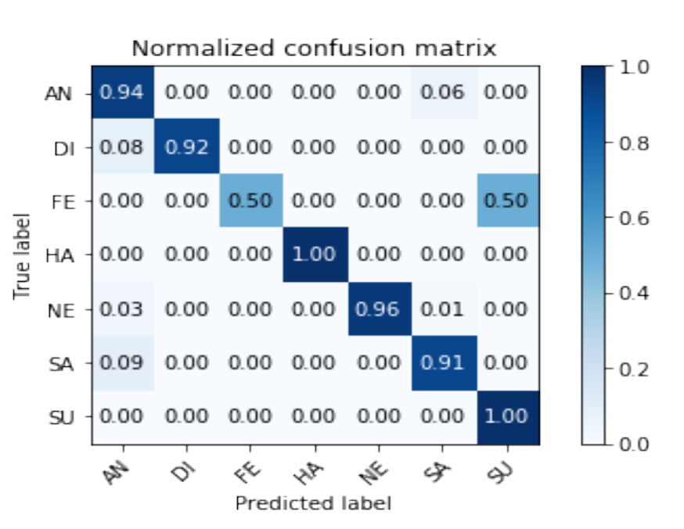
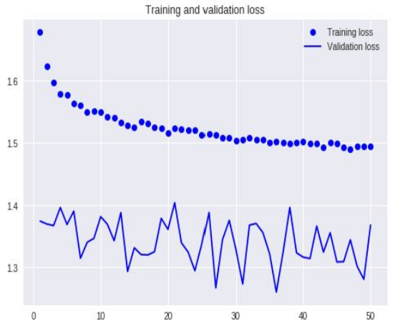
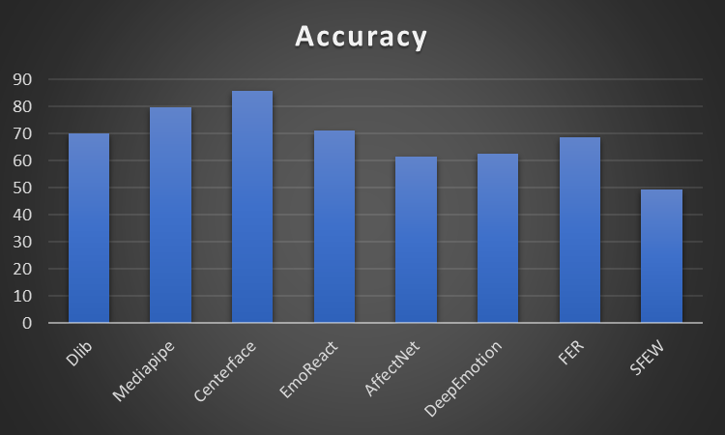
Accuracy
50-55%

Slide 9
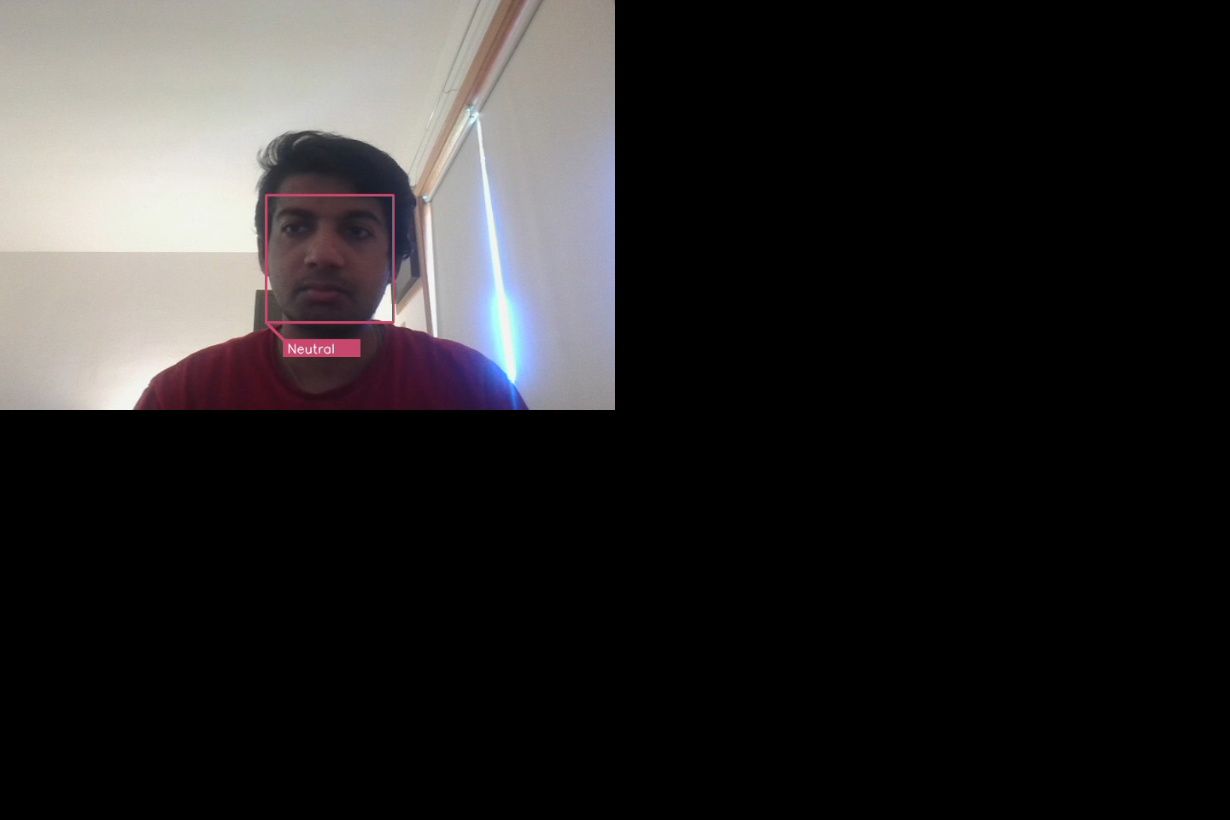
Demo

Slide 10
Website
Our work can be seen in detail on:
https://rama25.github.io/-Emotional-Analysis-Using-CNN/
We were able to embed OpenCV and TensorFlow into our JavaScript to provide a live demo to play with!

Slide 11
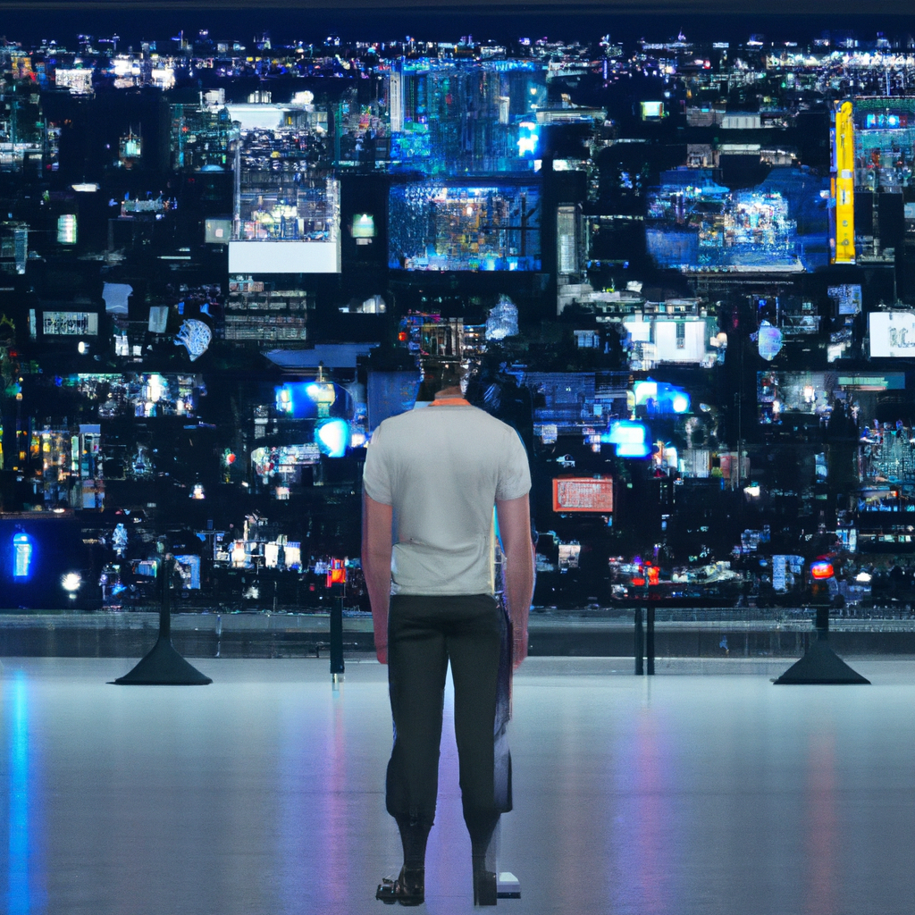
Conclusion
Real-time emotional analysis using OpenCV can transform the way we understand human emotions
It provides valuable insights into the emotional state of individuals
It can help improve communication, diagnose mental health conditions, and even prevent crime
Challenges include ensuring accuracy and addressing privacy concerns
The potential benefits of this technology are immense, and the field is evolving to provide more innovative applications and solutions.

Slide 12
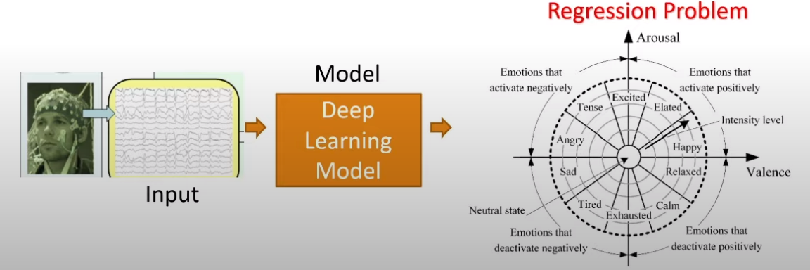
Future Work
Classification Problem -> Regression Problem using Body Sensors
Increase accuracy

Slide 13
References
[1] Cleynen I., Gonzalez J., Figueroa C., Franke A., McGovern D., Bortlik M., et al. (2013) Genetic factors conferring an increased susceptibility to develop Crohn’s disease also influence disease phenotype: results from the IBDCHIP European project. Gut 62: 1556–1565.
[2] E. Horvitz. Principles of mixed-initiative user interfaces. In Proceedings of CHI '99, ACM SIG CHI Conference on Human Factors in Computing Sys-tems, Pittsburgh, PA, ACM Press., pages 159-166,May 1999.
[3] Goodfellow, Ian J "Challenges in representation learning: A report on three machine learning contests" International conference on Neural Information Processing Berlin 2013
[4] Accenture. (2021). The future of work: Productive anywhere. Retrieved in February 2023 from: https://www.accenture.com/_acnmedia/PDF-155/Accenture-Future-Of-Work-Global-Report.pdf#zoom=40
[5]Fragopanagos, N., & Taylor, J. G. (2005). Emotion recognition in human–computer interaction. Neural Networks, 18(4), 389–405. https://doi.org/10.1016/j.neunet.2005.03.006
[6]Hossain, M. S., & Muhammad, G. (2017). An emotion recognition system for mobile applications. IEEE Access (5), 2281-2287. https://ieeexplore.ieee.org/document/7862118
[7]Podoletz, L. (2022). We have to talk about emotional AI and crime. AI & Society. https://doi.org/10.1007/s00146-022-01435-w
[8]Suk, M., & Prabhakaran, B. (2014). Real-Time Mobile Facial Expression Recognition System -- A Case Study. 2014 IEEE Conference on Computer Vision and Pattern Recognition Workshops. https://doi:10.1109/cvprw.2014.25

